Slide 1
The greedy method
Suppose that a problem can be solved by a sequence of decisions. The greedy method has that each decision is locally optimal. These locally optimal solutions will finally add up to a globally optimal solution.
Only a few optimization problems can be solved by the greedy method.

Slide 2
What makes a greedy algorithm?
Feasible
  Has to satisfy the problem’s constraints
Locally Optimal
  The greedy part
  Has to make the best local choice among all feasible choices available on that step
    If this local choice results in a global optimum then the problem has optimal substructure
Irrevocable
  Once a choice is made it can’t be un-done on subsequent steps of the algorithm
Simple examples:
  Playing chess by making best move without lookahead
  Giving fewest number of coins as change
Simple and appealing, but don’t always give the best solution

Slide 3
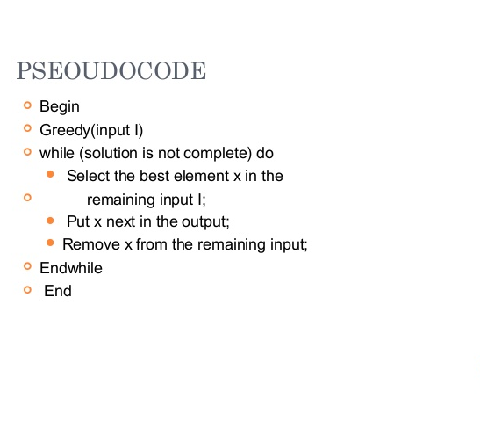
The greedy method working

Slide 4
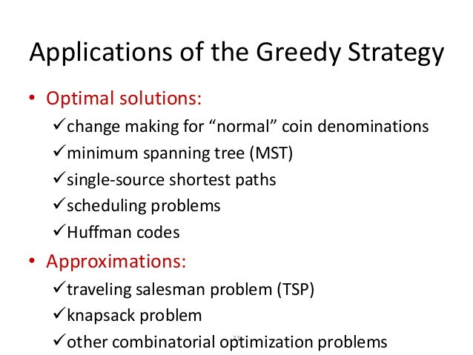

Slide 5
KNAPSACK PROBLEM
We review the knapsack problem and see a greedy algorithm for the fractional knapsack.
We also see that greedy doesn’t work for the 0-1 knapsack (which must be solved using DP).

Slide 6
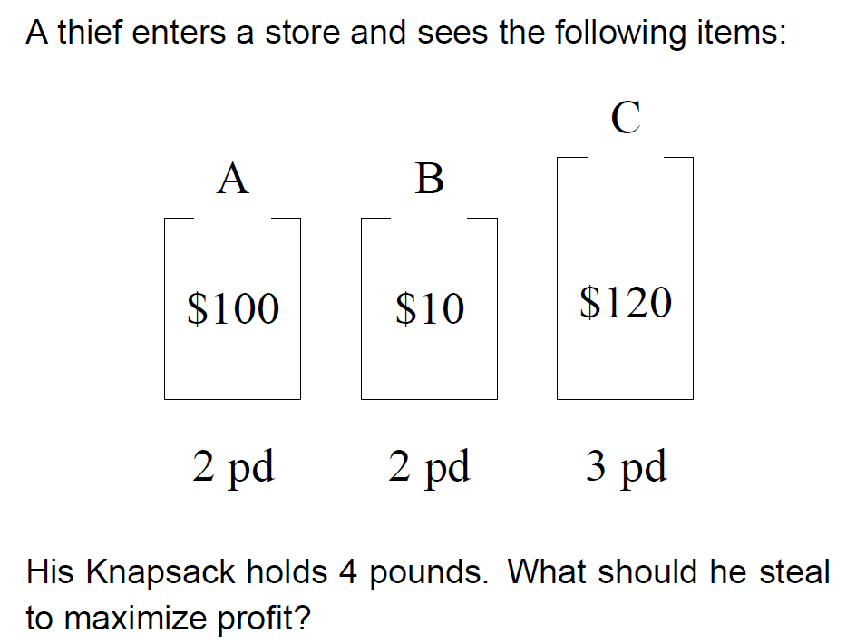
KNAPSACK
PROBLEM

Slide 7
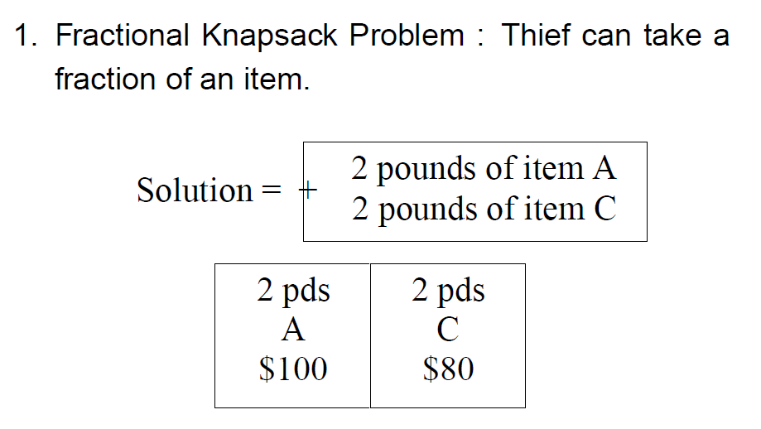
FRACTIONAL KNAPSACK PROBLEM

Slide 8
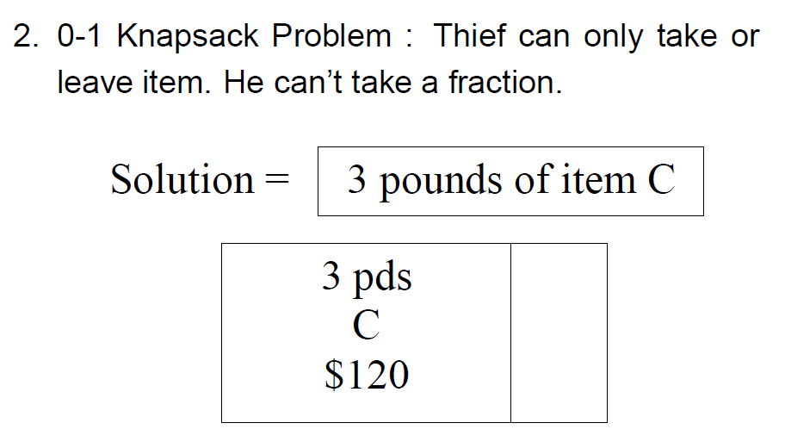
0/1 DISCRETE KNAPSACK PROBLEM

Slide 9
KNAPSACK PROBLEM GENERAL
Let us apply the greedy method to solve the knapsack problem. We are given ‘n’ objects and a knapsack. The object ‘i’ has a weight wi and the knapsack has a capacity ‘m’. If a fraction xi, 0 < xi < 1 of object i is placed into the knapsack then a profit of pi xi is earned. The objective is to fill the knapsack that maximizes the total profit earned.

Slide 10
The knapsack problem problem statement
n objects, each with a weight w_{i} > 0
a profit p_{i} > 0
capacity of knapsack: M
Maximize
Subject to
0 ≤ x_{i} ≤ 1, 1 ≤ i ≤ n

Slide 11
Algorithm
If the objects are already been sorted into non-increasing order of p[i] / w[i] then the algorithm given below obtains solutions corresponding to this strategy.
Algorithm GreedyKnapsack (m, n)
// P[1 : n] and w[1 : n] contain the profits and weights respectively of
// Objects ordered so that p[i] / w[i]> p[i + 1] / w[i + 1].
// m is the knapsack size and x[1: n] is the solution vector.
{
for i := 1 to n do x[i] := 0.0 // initialize x
U := m;
for i := 1 to n do
{
if (w(i) > U) then break;
x [i] := 1.0; U := U – w[i];
}
if (i < n) then x[i] := U / w[i];
}

Slide 12
Running time: The objects are to be sorted into non-decreasing order of pi / wi ratio. But if we disregard the time to initially sort the objects, the algorithm requires only O(n) time.
Example: Consider the following instance of the knapsack problem: n = 3, m = 20,
(p1, p2, p3) = (25, 24, 15) and (w1, w2, w3) = (18, 15, 10).

Slide 13
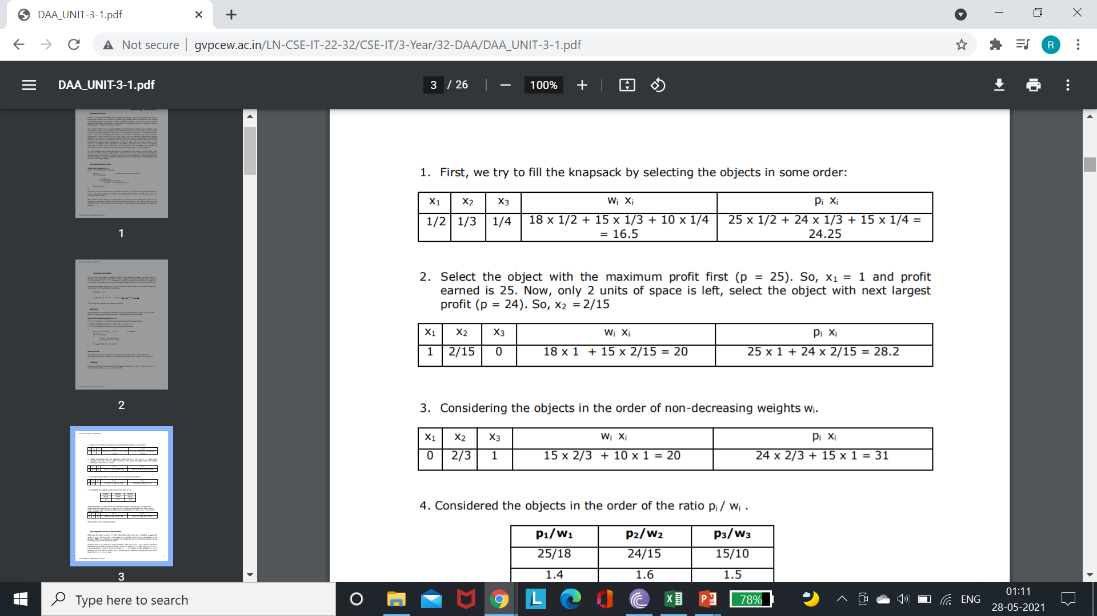

Slide 14
